Slide 1
Sprint Valve Maintenance

Slide 2
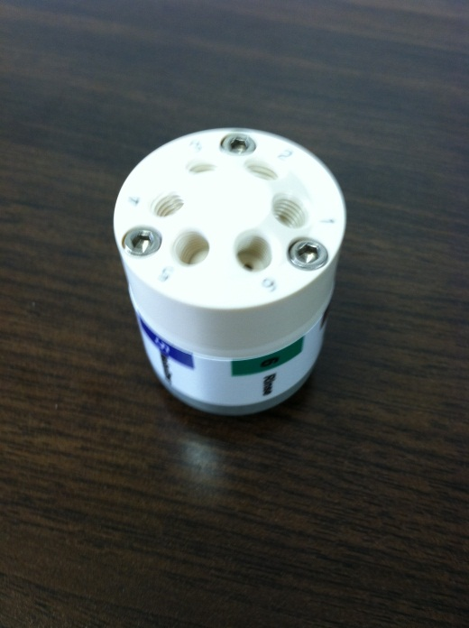
Routine Maintenance
Cleaning the 6-port valve
1x per week for normal operations, more for methods involving high TDS
Tools Needed: 9/64” hex wrench, 3/32” hex wrench

Slide 3
Maintenance: 6-port valve
Dry out the loop
Send the probe to the “Home” position above the rinse station
Set valve to “Load”,
Turn the vacuum pump on until loop is dry.
Turn vacuum pump off
Remove all connections from the 6-port valve.
Take care with nebulizer connection
Accessing the Sprint Valve Manual Control Functions
1) From the Dashboard in Qtegra select the ASX-560
2) Click on the Sprint Valve tab
3) The manual control functions will appear

Slide 4
Maintenance: 6-port valve
Use a 9/64” hex wrench to loosen the metal collar
Does not need to be completely removed, just loosened enough to pull off 6-port valve.

Slide 5
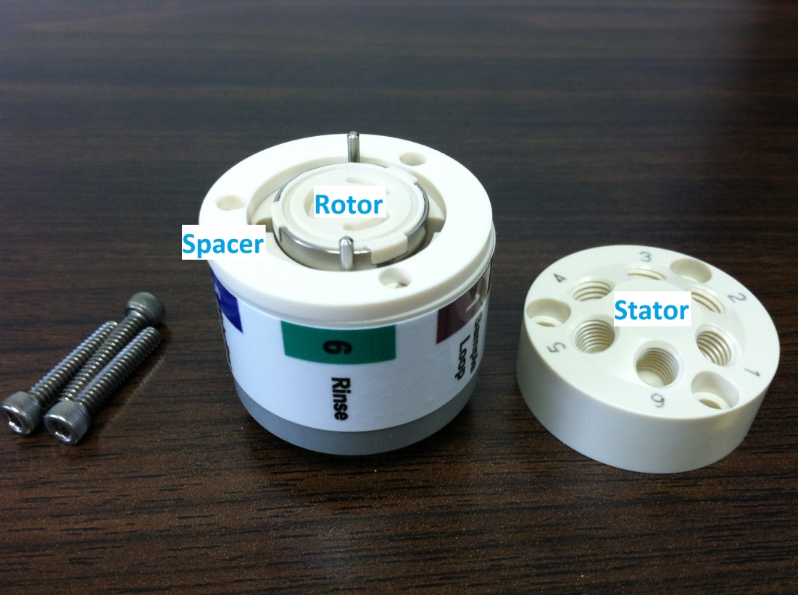
Maintenance: 6-port valve
Use a 3/32” hex wrench to loosen the three screws and remove the stator, ring spacer, and rotor.

Slide 6
Maintenance: 6-port valve

Slide 7
Maintenance: 6-port valve

Slide 8
Maintenance: 6-port valve
Sonicate for ~ 30 minutes in solvent relevant to your application (i.e. acid for aqueous matrices)
Inspect rotor and stator for scratches or blockage
Use argon, nitrogen or other clean gas (not canned air) to remove any lingering particles from the surfaces and ports

Slide 9
Maintenance: 6-port valve
Reassemble 6-port valve
Only fits together one way
Tighten three 3/32” hex screws incrementally in a circle (as if changing a tire). Do not over-tighten!

Slide 10
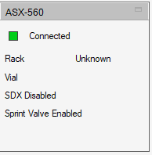
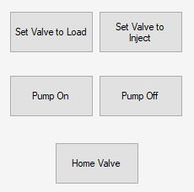
Re-homing 6-port valve
Accessing the Sprint Valve Manual Control Functions
1) From the Dashboard in Qtegra select the ASX-560
2) Click on the Sprint Valve tab
3) The manual control functions will appear
Before reinserting valve, use the manual control function in Qtegra to switch the valve position from Load to Inject.
V/P module will make a long tone noise
Reinsert the 6-port valve in the V/P module and tighten the collar.
Valve should not move when switched.
Click which will toggle valve between load and inject positions several times
V/P module makes a chirping noise when properly homed
Notes:
Display Valve ‘retraining’ document

