Slide 1
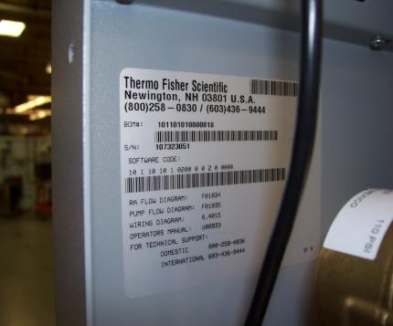
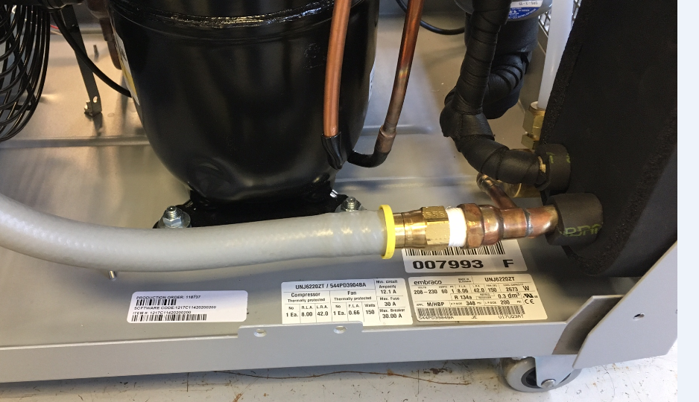
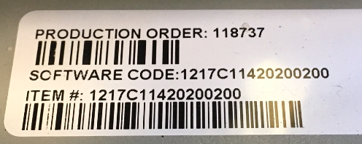
ThermoFlex Control Board Configuration – Pg 1 of 3
Unlike the Merlin & Pegasus units, ThermoFlex is configured with the software code, Not the BOM number.
The software code can be found either on the serial tag behind the HMI or on the base of the unit. If it is an older unit and the code referenced here is 20 digits you will have to get the new 16 digit code from Thermo Fisher to configure a new replacement control board.
Note: I found this inside the right cover, on the bottom of the chiller – It could be viewed through the air vents on the right side.

Slide 2
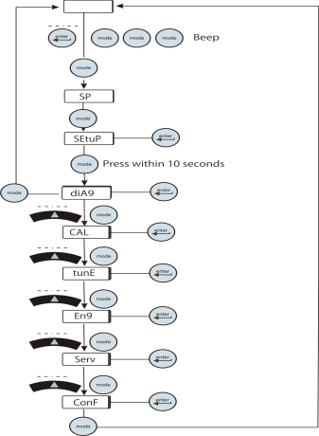
ThermoFlex Control Board Configuration – Pg 1 of 3
Enter Configuration Loop as shown
XX.X deg C
Press “Mode” 3 times until “diA9” is observed and release Mode button.
2. Hold the Up arrow and push “Mode” 5 times until “ConF” is observed and release Up arrow and Mode buttons and then press Enter
Ignore these

Slide 3
Understanding the Software Code
The Chiller software code should look similar to:
This is then broken down in the ConF programing
Unit:
Cooling Temp:
Voltage:
Pump: Controller/safety:
AR/AD/DI:
Flow Option:
Communication:
Heater:
Compliance:
Filter:
Reserved:
Country Code:
Reserved:
Reserved:
1111C10500200000
11 1 1 C 1 0 5 0 0 2 0 0 0 0 0

Slide 4
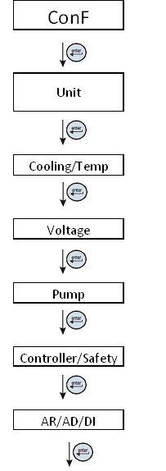
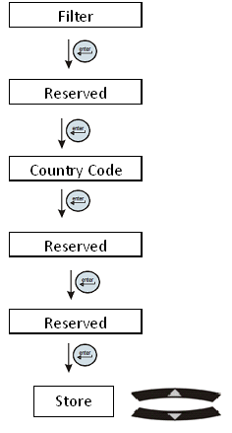
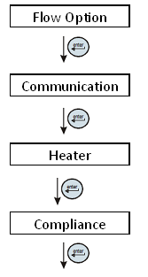
ThermoFlex Control Board Configuration – Pg 1 of 3
2. Scroll through Configuration Loop entering the software code segment into each field
3. Press Yes to Store data.
> NOTE: The unit code will be 2 digits, all the other codes are 1 digit.
Up to save

